Slide 1
Op-amp Design (expt.5)
Design and simulate in PSPICE, an operational amplifier circuit.
The four ‘building blocks’ are:
differential input stage (long-tailed pair)
common emitter amplifier
emitter follower
current mirror circuit
Briefly investigate each of these circuits in turn before combining them to produce the operational amplifier circuit to a given specification.
These slides are on VITAL under ‘Assignments’

Slide 2
Specification
Differential input impedance, R_{id} > 100kΩ
Voltage gain (A_{ol}) greater than 500,000
Output impedance, R_{o} < 1kΩ
Output voltage to be ‘zero’ volts for zero input
Frequency response down to D.C.
Supply voltage +9 to -9 V
total current consumption not greater than 5mA

Slide 3
DC characteristics [see ‘Part 2’ slides on VITAL]
I_{C}
Common-emitter, DC current gain
I_{B}
Common-emitter, AC current gain
V_{CE}
Q: How could we estimate AC gain from DC characteristics?
c
b
Note: different notation
e

Slide 4
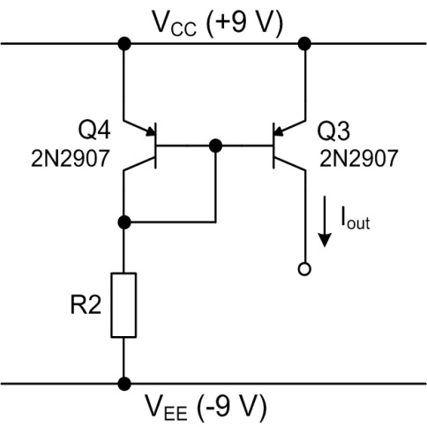
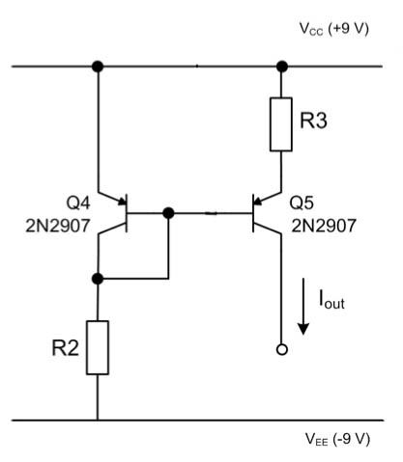
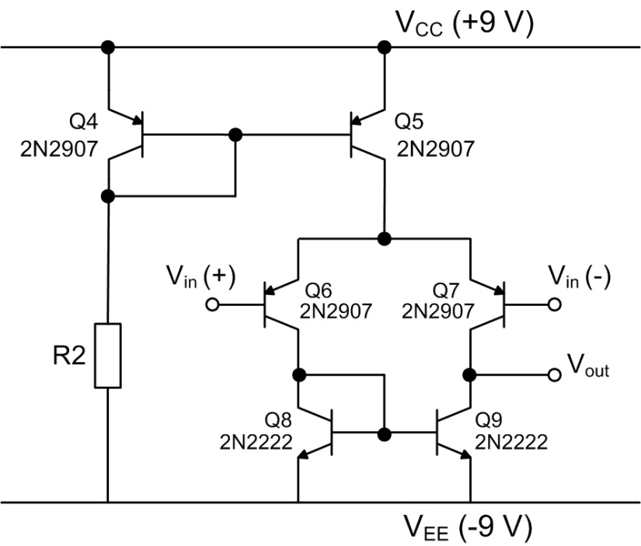
Pre-lab
Learn how to design the ‘building blocks’
Part 2 Notes
EF and CE stages
Part 4 Notes
Simple CM
Part 2 Notes
Simple CM
Part 4 Notes
Widlar CM
Part 3 notes
Differential Amp
Part 5 Notes
Active loads

Slide 5
Putting it together...
Differential Amplifier
Emitter Follower
Common
Emitter
Vout
May need another block to meet the spec on R_{OUT}....
V_{CC}
A CC stage to match the input and CE voltage gain stages
V_{CC}
V_{CC}
Use an active load here, not a resistor or you won’t get enough gain
V_{EE}
V_{EE}
V_{EE}
Always check the dc levels (voltages, currents) first
Remember loading effects of one stage on another

Slide 6
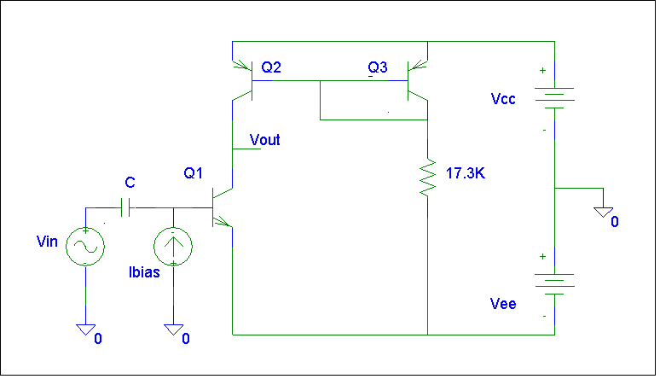
CE amp with CM load
V_{CC} = 9V, V_{EE} = -9V
What is the V-drop across the resistor?
What value will give 1mA?
V_{CC}
R
V_{EE}
Can use this to check the gain once you have it biased correctly
Set I_{C} to your desired value
Choose I_{bias} to set V_{out} = 0V
(use a dc sweep of I_{bias} as before)

Slide 7
Output resistance of a CE amp with CM load
V_{CC} = 9V, V_{EE} = -9V
What is the V-drop across the resistor?
What value will give 1mA?
V_{CC}
R
V_{EE}
If the CE is connected to a load (another stage), it’s ac load is
You can find the Early voltage from the model listing for the transistor
Same analysis applies for the Diff Amp output

Slide 8
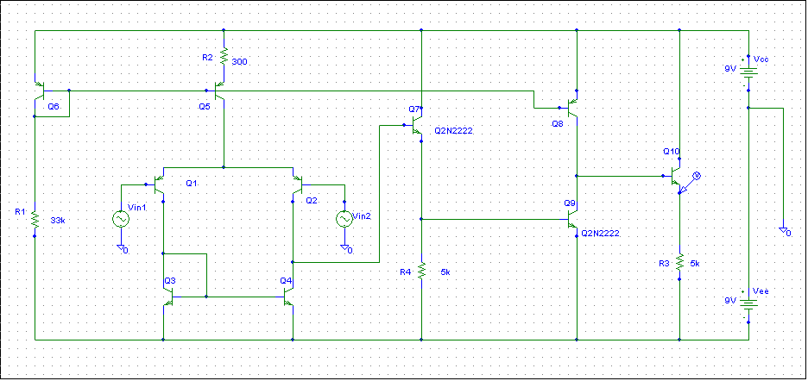
Matching the Diff Amp to the CE
I?
R_{E}
V?
R_{E} effectively acts as a current source (with V_{EE})
Ac load for Diff. amp. is

Slide 9
The VTC is a handy way to estimate gain
First, look at the Voltage Transfer Curve (VTC) of an amplifier.
Sweep the voltage on the positive input
Attach the negative input to ground)

Slide 10
Or: alternative way to measure A_{ol}
Measuring the very high A_{ol} is problematic as the amplifier is unstable.
A method for measuring A_{ol} is shown below.
10k
v_{Y}
10k
v_{i}
+
10k
-
100R
+
v_{o}
Exercise: Prove the equation by equating currents between v_{Y} and ground

Slide 11
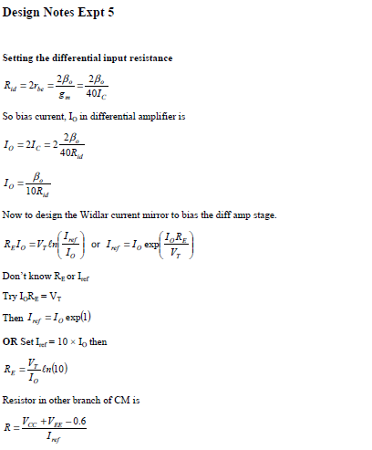
Hints for calculations (VITAL, ‘Assignments’)

Slide 12
Some advice
Study the script and think about the design beforehand..
Use your ELEC271 notes!
Bring your record of the pre-lab questions to the laboratory – needed when designing the complete OPAMP circuit.
Always check dc levels FIRST!! – check they are as expected
Remember loading effects of one stage on another (Part 2 notes)
Ask questions
Good luck

